Slide 1

Campus_Eats_Fall2020 Database
Jyosthna Gandhodi- 801254449
Sree Gauthami Gundaram- 801257596
Aparna Reddy Pothula- 801203669
Manswini Ragamouni- 801217775

Slide 2
Project Overview:
Introduction:
Food delivery services have become an important part of our everyday life. It is critical for institutions like UNCC to maintain track of the visitors and authorized personnel that come to campus every day. We have created Campus_Eats_Fall2020 database which represents as a small sized restaurant. It contains all the data required to function a restaurant properly. This project involves designing a database to store the details of the delivery, driver, faculty, location, order, person, restaurant, staff, student and vehicle. Users can search for restaurants and place orders. The order will be assigned to a delivery person.

Slide 3
Implementation of Rating tables:
Business rules:
• Each user can rate Order, Driver and Food.
• Each order can have 3 kinds of rating.
• Each order can have one driver rating.
• Each order can have one food rating.
• Each order has an Overall Rating.
• Each driver can have many rating.

Slide 4
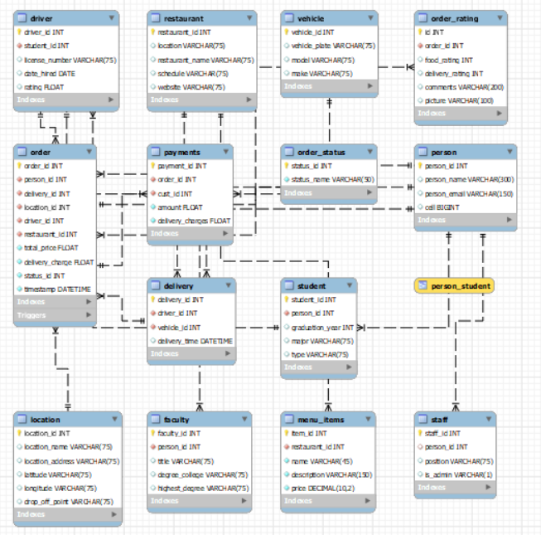
EERD Diagram:

Slide 5
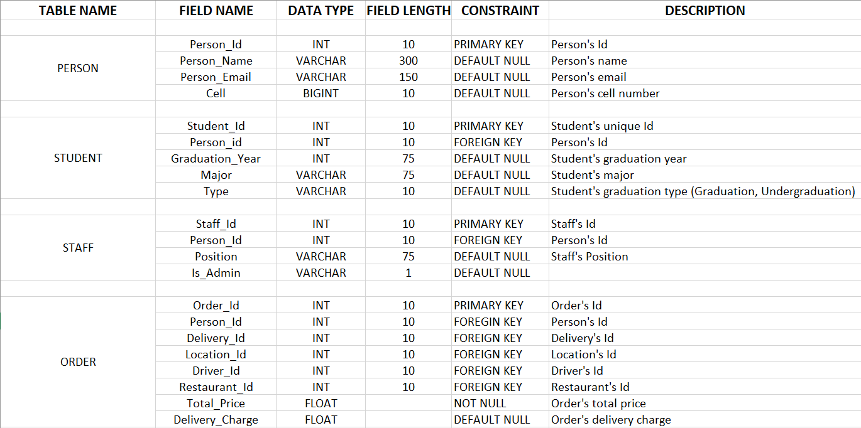
Data Dictionary:

Slide 6
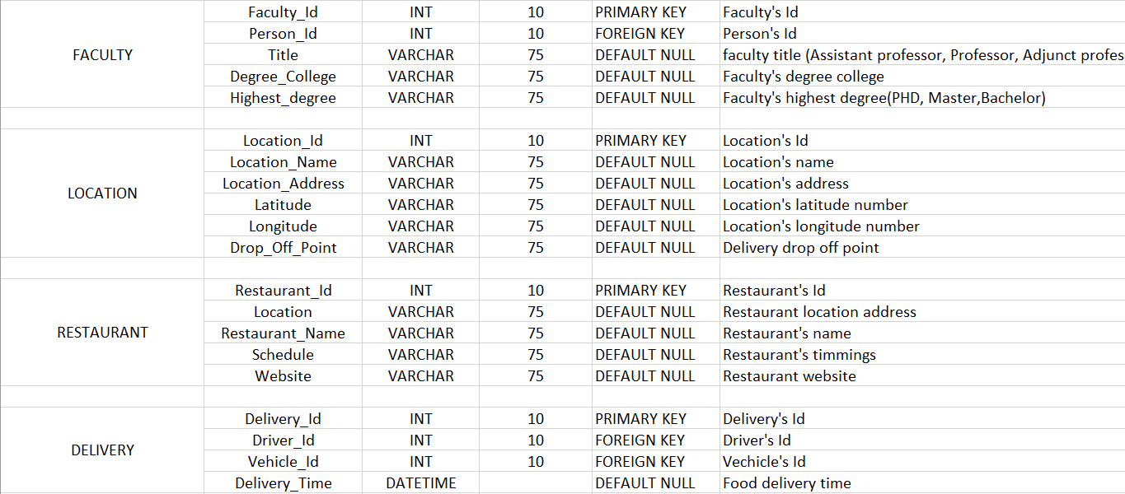
Data Dictionary:

Slide 7
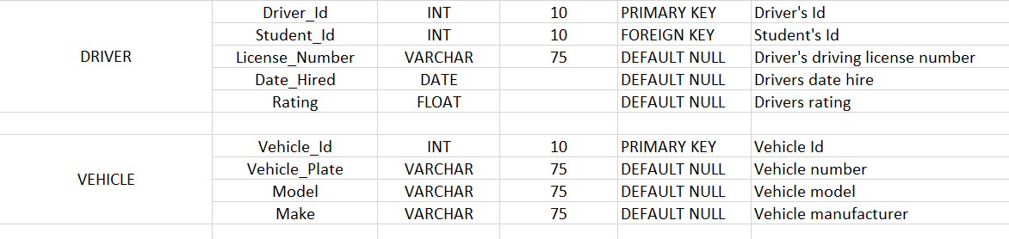
Data Dictionary:

Slide 8
Stored Procedures-1:
USE
Campus_eats_fall2020;
DROP PROCEDURE IF EXISTS count_of_orders;
DELIMITER //
CREATE PROCEDURE count_of_orders(IN start_year INT,IN end_year INT, OUT output_str varchar(100))
BEGIN
DECLARE order_count Varchar(20);
SELECT count(*) into order_count
FROM `order`
WHERE person_id in (
select person_id from student where graduation_year between start_year and end_year
);
IF order_count < 0 THEN
SET output_str = CONCAT("The number of orders are 0");
ELSE
SET output_str = CONCAT("The number of orders are ", order_count);
END IF;
END //
DELIMITER ;
-- Gets number of orders from 2010 to 2013
CALL count_of_orders(2009,2013,@output_str);
Select @output_str

Slide 9
Stored Procedure-2:
USE campus_eats_fall2020;
DROP PROCEDURE IF EXISTS get_min_max_avg_rating_for_restaurant;
DELIMITER //
CREATE PROCEDURE get_min_max_avg_rating_for_restaurant (IN restaurant_id INT(50), OUT max_food INT, OUT min_food INT, OUT avg_food INT, OUT max_del INT, OUT min_del INT, OUT avg_del INT)
BEGIN
SET max_food = 0;
SET min_food = 0;
SET avg_food = 0;
SET max_del = 0;
SET min_del = 0;
SET avg_del = 0;
SELECT MAX(food_rating)
INTO max_food
FROM order_rating
LEFT JOIN campus_eats_fall2020.order
ON order_rating.order_id = campus_eats_fall2020.order.order_id
where campus_eats_fall2020.order.restaurant_id = restaurant_id;
SELECT MIN(food_rating)
INTO min_food
FROM order_rating
LEFT JOIN campus_eats_fall2020.order
ON order_rating.order_id = campus_eats_fall2020.order.order_id
where campus_eats_fall2020.order.restaurant_id = restaurant_id;

Slide 10
Stored Procedure-2:
SELECT AVG(food_rating)
INTO avg_food
FROM order_rating
LEFT JOIN campus_eats_fall2020.order
ON order_rating.order_id = campus_eats_fall2020.order.order_id
where campus_eats_fall2020.order.restaurant_id = restaurant_id;
SELECT MAX(delivery_rating)
INTO max_del
FROM order_rating
LEFT JOIN campus_eats_fall2020.order
ON order_rating.order_id = campus_eats_fall2020.order.order_id
where campus_eats_fall2020.order.restaurant_id = restaurant_id;
SELECT MIN(delivery_rating)
INTO min_del
FROM order_rating
LEFT JOIN campus_eats_fall2020.order
ON order_rating.order_id = campus_eats_fall2020.order.order_id
where campus_eats_fall2020.order.restaurant_id = restaurant_id;

Slide 11
Stored Procedure-2:
SELECT AVG(delivery_rating)
INTO avg_del
FROM order_rating
LEFT JOIN campus_eats_fall2020.order
ON order_rating.order_id = campus_eats_fall2020.order.order_id
where campus_eats_fall2020.order.restaurant_id = restaurant_id;
END //
DELIMITER ;
CALL get_min_max_avg_rating_for_restaurant(2,@Max_Food_Rating,@Min_Food_Rating, @Avg_Food_Rating, @Max_Del_Rating, @Min_Del_Rating, @Avg_Del_Rating);
SELECT @Max_Food_Rating, @Min_Food_Rating, @Avg_Food_Rating, @Max_Del_Rating, @Min_Del_Rating, @Avg_Del_Rating ;

Slide 12
Indexes:
DROP TABLE IF EXISTS `order_rating`;
 | CREATE TABLE IF NOT EXISTS `campus_eats_fall2020`.`order_rating` (
 | `id` INT NOT NULL,
 | `order_id` INT NOT NULL,
 | `food_rating` INT NULL,
 | `delivery_rating` INT NULL,
 | `comments` VARCHAR(200) NULL,
 | `picture` VARCHAR(100) NULL,
 | PRIMARY KEY (`id`),
 | INDEX `order_id_idx` (`order_id` ASC),
 | CONSTRAINT `order_id`
 | FOREIGN KEY (`order_id`)
 | REFERENCES `campus_eats_fall2020`.`order` (`order_id`))
 | ENGINE = InnoDB

Slide 13
Views:
USE `campus_eats_fall2020`;
CREATE OR REPLACE VIEW `customer_orders` AS
SELECT DISTINCT person_id as customer_id,
ROUND(total_price + delivery_charge) AS order_total
FROM campus_eats_fall2020.order
GROUP BY person_id;
select * from customer_orders

Slide 14
Functions:
DROP FUNCTION IF EXISTS funct_driver_rating;
DELIMITER //
CREATE FUNCTION funct_driver_rating
(
rating INT
)
RETURNS varchar(30)
deterministic
BEGIN
DECLARE rating_comment varchar(30);
IF rating = 1 THEN
SET rating_comment = "Worst driver";
ELSEIF rating = 2 THEN
SET rating_comment = "Bad driver";
ELSEIF rating = 3 THEN
SET rating_comment = "Average driver";
ELSEIF rating = 4 THEN
SET rating_comment = "Good driver";
ELSEIF rating = 5 THEN
SET rating_comment = "Excellent driver";
END IF;
RETURN rating_comment;
END//
DELIMITER ;
select driver_id, funct_driver_rating(rating) from driver;

Slide 15
Thank You

